Slide 1

ConnectTel Call Centre
Vuuma Presentation

Slide 2
TABLE OF CONTENTS
Page 1 – Objectives
Page 2 – Where is demand
Page 3 – Overtime vs Shift
Page 4 - Team Performance
Page 5 – What drives costs
Page 6 - Recommendations
Page 7 - Risks

Slide 3
Objectives Cost and Performance review
Identify drivers of high costs
Spot inefficiencies
Recommend Improvements

Slide 4
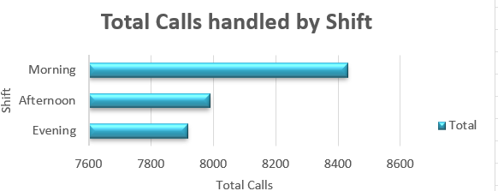
Where is the demand
The morning shift has the highest calls
handled, while the evening has the
least.
This clearly shows when the most demand
is and which shifts to invest more overtime
hours in.

Slide 5
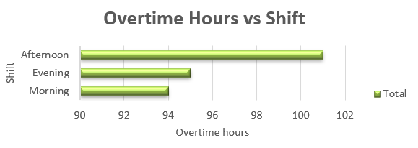
Overtime hours Invested in shifts
Afternoon has highest overtime
hours.
Contrary to the first observation,
mornings have the least overtime
hours.
This shows an imbalance of shift
priority as well as inefficiency.

Slide 6
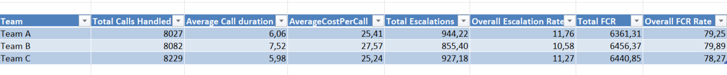
Team Performance
- Team B has the highest average calls duration
- Team B has the highest average cost per call
- Team B a slightly high escalation rate
- This suggests more costs and inefficiency from Team
B.

Slide 7
What is driving high costs?
Longer call durations increase costs.
Overtime is not aligned with demand.
High escalation times increase handling time.
Team B’s average duration is 20% longer than Team C, with 9% higher cost per call.

Slide 8
Recommendations
Review Team B call handling and provide training for better call handling.
Align staffing with peak demand. More overtime hours for the morning and afternoon shifts. - Focus more especially on team B, they put more hours in the least peak shift.
Target agents with high escalation rates for coaching

Slide 9
Risks and Assumptions
Risk 1 – Escalations May Reflect Complexity and not Poor Performance
High escalation rates do not necessarily indicate poor service quality. Some teams may handle more complex customer issues, which then require escalation.
Risk 2 – Call Complexity
The dataset does not include a measure of call complexity. Longer duration or higher cost may suggest more difficult cases rather than inefficiency.
Risk 3 – Timeframe Limitation
The analysis is based on the available time period and may not reflect long-term trends or seasonal variation.

